Slide 1
PepsiCo
Contract Manufacturing
pep+ Plan Creation Playbook

Slide 2
Table of Contents
Introduction | Slides: 3-7
Step 1: Assess current state | Slides: 8-10
Step 2: Set the target(s) | Slides: 11-14
Step 3: Identify & quantify improvement opportunities | Slides: 15-21
Step 4: Prioritize & build the pep+ Plan | Slides: 22-26
Step 5: Execute, track, & report progress | Slides: 27-29
Need help? Please contact your PepsiCo relationship manager

Slide 3
Introduction

Slide 4

Introduction & Background Information
Through the standard Sustainability Clause, we document commitment of partners have agreed to pep+ Plan creation (see right)
This Playbook is intended to be used by Contract Manufacturing Managers (CMMs), together with each of their facilities, to develop each facility’s pep+ Plan by the end of the year.
PepsiCo needs every partner along the value chain to begin working on sustainability this year in order to achieve our climate change and water pep+ goals (see appendix slides 31-33 to review these goals)

Slide 5



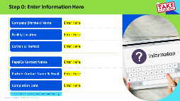
How to Use This Playbook
This playbook is intended to be used by CMMs in conversation with each individual facility
If a company produces PepsiCo products at three different facilities, there should be three separate completed playbooks
The pep+ Plan is a 5-step process, and there is a section within this playbook to walk you through each step that should be completed in the meeting, together with the facility. For an overview of the process, take the ~20-minute degreed training here (search for “Focus Areas & pep+ Plan Creation with 3rd Party Manufacturers”)
Assess
Current State
Set
Targets
Identify & Quantify Improvement Opportunities
Build the
pep+ Plan
Execute, Track, & Report Progress
Slides where YOU need to
take action: Look for the
green headers and this icon:

Slide 6


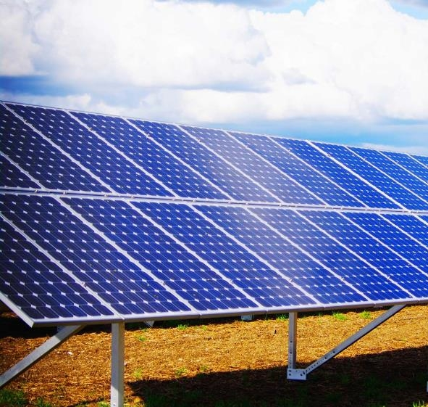



Step 0: Start By Doing These Things
1
CMMs should start by setting up a 1.5-hour meeting with each facility, and inviting their sustainability contact (can be found on our Contact Persons List on 3PM Teams/General/Supplier Management/Supplier Comms, Email in column N), plant engineers, and budget decision-makers
Send a copy of this playbook as a pre-read
2
CMMs should ask the facility to come to the meeting prepared with the following, for use in the Reduction Finder Tool in Step 3:
Total facility electricity use for 1 year (in kWh)
Renewable electricity use for 1 year (if any, in kWh)
PepsiCo production volume at this facility for 1 year
Total production volume at this facility for 1 year
(they can keep this confidential from PepsiCo if they wish)

Slide 7

Step 0: Enter Information Here
Company (Partner) Name
Enter Here
Facility Location
Enter Here
CoMan or RePack
Enter Here
PepsiCo Contact Name (CMM)
Enter Here
Partner Contact Name & Email
Enter Here
Completion Date
Enter Here
*Complete this Playbook once with each facility
7

Slide 8


Step 1:
Assess Current State
Assess
Current State
Set
Targets
Identify & Quantify Improvement Opportunities
Build the
pep+ Plan
Execute, Track, & Report Progress

Slide 9
Climate Change: Document the Answers to these
Questions Here
 | Yes | No
Have they measured their baseline scope 1 & 2 greenhouse gas emissions footprint for each facility and submitted it to us through the annual survey? pep+ Dashboard LINK (login required)
Have they set their own climate change goal(s) for their organization? pep+ Dashboard LINK (login required)
Have they initiated Science Based Targets (SBT) approval for their target? pep+ Dashboard LINK (login required)
Have they received approval from Science Based Targets Initiative on their target? pep+ Dashboard LINK (login required)
Do they own this facility (answer Yes if owned, No if leased)
Are they currently sourcing renewable electricity? Question 5 on dashboard **Note: In order to answer “Yes”, they must also have the paperwork/documentation for the Guarantees of Origin (GOs) or Renewable Energy Certificates (RECs) or International RECs (I-RECs) for this renewable electricity procurement
Do they have a resource conservation program currently in place involving GHG emissions/energy use at this facility?
Do they have a detailed plan in place to achieve the pep+ climate change goals currently? (see slides 24)
SUM:

Slide 10
Water: Document the Answers to these Questions Here
 | Yes | No | NA
Have they measured their baseline water footprint for each facility and submitted it to us through the annual survey? pep+ Dashboard LINK (login required)
Have they set their own water goal(s) for their organization? pep+ Dashboard LINK (login required)
Do they know whether they are in a non-high or a high-water risk watershed?
Foods Coman For non-high water risk locations, do they use less than 4.4 liter of water per KG of food produced today? For high water risk locations, do they use less than 0.4 liter of water per pound of food produced today? Beverage Coman For non-high water risk locations, do they use less than 1.4 liter of water per liter of food produced today? For high water risk locations, do they use less than 1.2 liter of water per pound of food produced today?
If no to the question above, have they decided whether they are working to achieve the pep+ absolute or percentage water targets for each facility (see slide 33)?
For high water risk locations only, do they replenish any portion of their water use today?
Do they have a resource conservation program currently in place involving water at this facility?
Do they have a detailed plan in place to achieve the pep+ water goals currently?
SUM:

Slide 11
Step 2:
Set & Document
Targets
Assess
Current State
Set
Targets
Identify & Quantify Improvement Opportunities
Build the
pep+ Plan
Execute, Track, & Report Progress

Slide 12
Step 2 Instructions
Step 1 should have given you an understanding of whether the partner has their own climate change and/or water target(s) already.
Climate Change
Water
If they do not
have their own target
If they have a target but it is not approved by SBT
If they have an approved SBT or are going through the SBT approval process
If they do not
have their own target
If they have their own target(s) but they are less aggressive than the pep+ goals
(see slide 33)
If they have their own targets that are at least as aggressive as the pep+ goals (see slide 33)
Direct them to the provided resources on the next slide and encourage them to begin working on setting their own target immediately
Proceed to slide 14 within this playbook
Encourage them to adopt targets that are at least as aggressive as the pep+ water goals (see slide 33), then proceed to slide 14
Encourage them to increase the ambition of their goals and remind them that all PepsiCo partners will need to achieve the pep+ water goals by 2030, then proceed
to slide 14
Proceed to slide 14 within this playbook

Slide 13

Climate Change Goal-Setting Resources for Companies without Targets
Listen to a free 30-minute e-learning course around the process of setting Science-based targets
Look at the guidance provided by the Science Based Targets Initiative, including the SBT How-to Guide and Science Based Targets Overview documents to the right
Read the file to the right to learn more about the Climate School. Let us know via PepsiCo relationship manager if you would like to participate in the next season to get more help setting your target.
Note: Documents can also be downloaded here or attached to the external email

Slide 14
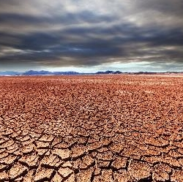


Document the Partners’ Exact Goal Wording Here
Add text here
Climate Change
Add text here
Water
Note: If the company does not yet have goals in place, direct them to the provided resources on the previous slide and encourage them to begin working on setting their own target immediately. Put “TBD” here and proceed to step 3.

Slide 15
Step 3:
Identify & Quantify Improvement
Opportunities
Assess
Current State
Set
Targets
Identify & Quantify Improvement Opportunities
Build the
pep+ Plan
Execute, Track, & Report Progress

Slide 16
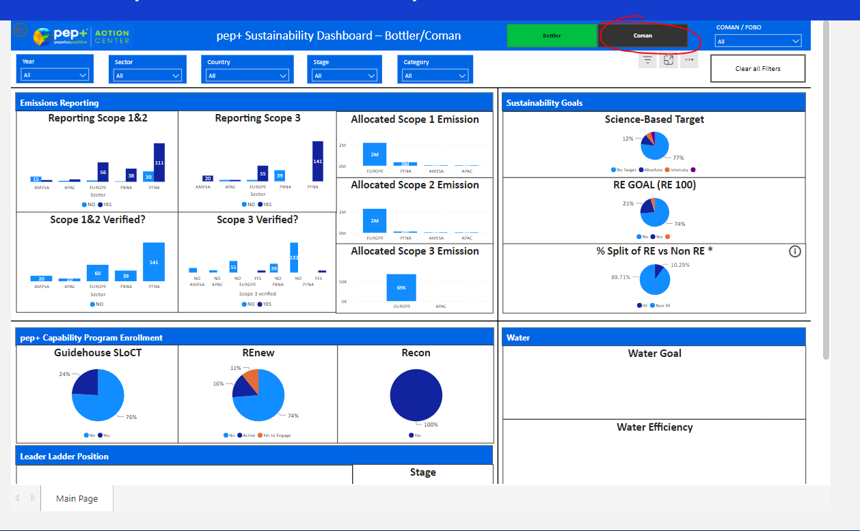
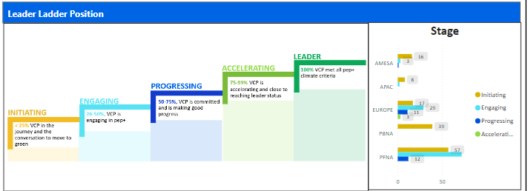
Step 3 Instructions (Page 1 of 2)
1
Navigate to the pep+ Dashboard and filter for the facility at the top in the “Name of Organization” drop-down (as seen to the right).
  If the facility did not submit the annual survey (the GHG Footprint box or CoMans with Water Footprint box on the Requests tab says 0), have them complete the PepsiCo Water & Emissions Calculator found here or attached to the external email
2
Navigate to the “Input Playbook Climate” tab of the dashboard on the left and look for their last reported Scope 1/2 and Scope 3 emissions (on the right side in PowerBI). Document the numbers here:
  Scope 1 Emissions: ENTER HERE
  Scope 2 Emissions: ENTER HERE
  Scope 3 Emissions: ENTER HERE
3
Navigate to the “Input Playbook Water” tab of the dashboard on the left and look for their last reported Water Use. (add up the different types or enter ). Document the number here:
  Total gross water use: ENTER HERE
4
Document these data-points, which the facility should have come prepared to the meeting with (see slide 6):
  Total facility electricity use for 1 year (in kWh): ENTER HERE
  Renewable electricity use for 1 year (if any, in kWh): ENTER HERE
  PepsiCo production volume at this facility for 1 year: ENTER HERE
  Total production volume at this facility for 1 year (they can keep this confidential from PepsiCo if they wish): ENTER HERE

Slide 17
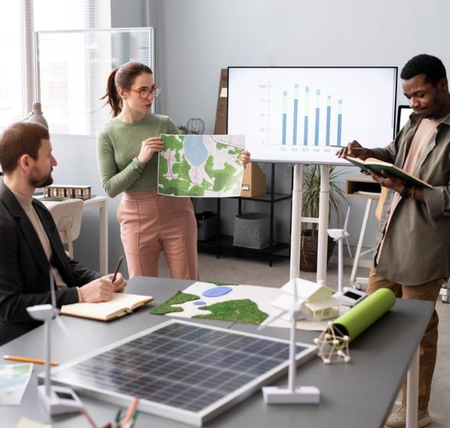
Step 3 Instructions (Page 2 of 2)
Download and save local copy of the Reduction Finder Tool here or attached to the external email. This tool is designed to provide you and the facility a menu of potential reduction opportunities.
5
6
Together with the facility, fill in the yellow cells on all the tabs of the Reduction Finder Tool using the numbers you collected on the previous page. Discuss which of the possible tactics yield the largest reductions, then proceed to the next slide.

Slide 18

Document the Partners’ Climate Waterfall Chart Here
Insert Waterfall chart from “Climate Change Reduction Finder” tab here
Waterfall Chart
Please note that these emissions reduction numbers are directionally accurate estimations only

Slide 19
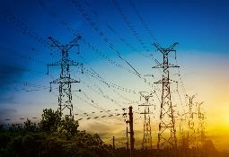
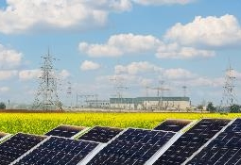
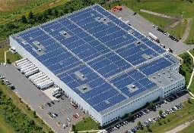
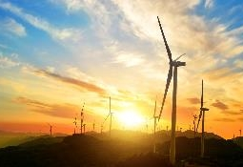
Context: There are 4 Main Methods of Renewable
Electricity Procurement
Unbundled Guarantee of Origins (GOs) or Energy Attribute Certificates (EACs)
Bundled GOs/EACs
Onsite Generation
Offsite / Power Purchase Agreements (PPAs)
GOs/EACs purchased separately from retail electricity agreements or utility tariffs
GOs/EACs obtained through
green retail electricity contracts
or green utility tariffs
GOs/EACs obtained through installed
generation at the site level
GOs/EACs obtained through virtual or physical power purchase agreements
Pros
Can be purchased quickly
Inexpensive
Can be incorporated into existing procurement processes
Inexpensive
High perceived impact
Longer-term solution
Greater sustainability impact
Longer-term solution
Cons
Lesser perceived impact
Subject to price volatility
Short term solution so must be renewed/re-purchased to continue making RE claims
Lesser perceived impact
Short term solution (e.g., 1-3 years) so must be renewed/
re-purchased to continue making
RE claims
Sizing may not be adequate to meet emissions reduction goals
Requires authority to install
Long-term investment/commitment
Complex deal structure
Long lead time, long contract, long-term investment/commitment
*Note on terminology: A REC (Renewable Energy Certificate) or Guarantee of Origins (GOs) is a type of Energy Attribute Certificate (EAC) that represents the environmental attributes of the generation of a one-megawatt hour (MWh) of energy produced by renewable sources.

Slide 20
Document the Partners’ Estimated Renewable Electricity
Pricing Here
Insert numbers from “Renewable Electricity Pricing” tab here. If the facility prefers to keep this information confidential, leave the full facility information blank.
Unbundled Guarantee of Origin (GOs)/Energy Attribute Certificates (EACs) | Yes |  | No
 | Low End |  | High End
Estimated cost to cover PepsiCo electricity use per year: | INSERT HERE | to | INSERT HERE
Estimated cost to cover facility electricity use per year: | INSERT HERE | to | INSERT HERE
Power Purchase Agreements (PPAs) | Yes |  | No
 | Low End |  | High End
Estimated cost to cover PepsiCo electricity use per year: | INSERT HERE | to | INSERT HERE
Estimated cost to cover facility electricity use per year: | INSERT HERE | to | INSERT HERE
Please note that market prices are subject to change, and these are estimations only
We strongly encourage facilities to cover their entire electricity load with renewable electricity

Slide 21
Document the Partners’ Climate Waterfall Chart Here
Insert Waterfall chart from “Climate Change Reduction Finder” tab here
Waterfall Chart
Please note that these water reduction numbers are directionally accurate estimations only

Slide 22
Step 4:
Prioritize & Build
PepsiCo Positive Plan
Assess
Current State
Set
Targets
Identify & Quantify Improvement Opportunities
Build the
pep+ Plan
Execute, Track, & Report Progress

Slide 23




Step 4 Instructions
Using the results found in Step 3, now it’s time to prioritize and build the PepsiCo Positive Plan (pep+ Plan) with each facility
The PepsiCo Positive Plan should determine exactly what the facility will do, and when they commit to doing it

Slide 24
Climate Change pep+ Plan
Climate Change Action | 2023 | 2024 | 2025 | 2026 | 2027 | 2028 | 2029 | 2030
Calculate footprint and submit to PepsiCo (annually) | X | X | X | X | X | X | X | X
Calculate & set climate change goal | X
Initiated Science Based Targets approval for goal | X
Receive approval from Science Based Targets Initiative on goal |  | X | X
Convert to 100% renewable electricity | e.g., 50% | e.g., 75% | e.g., 100% | e.g., 100% | e.g., 100% | e.g., 100% | e.g., 100% | e.g., 100%
Launch a Resource Conservation (ReCon) Program and Identify Point Person/Team | X
Enter other specific tactics here…
Enter other specific tactics here…
Enter other specific tactics here…
Enter other specific tactics here…
Enter other specific tactics here…
Enter other specific tactics here…

Slide 25
Water pep+ Plan
Water Action | 2023 | 2024 | 2025 | 2026 | 2027 | 2028 | 2029 | 2030
Calculate footprint and submit to PepsiCo (annually) | X | X | X | X | X | X | X | X
Set and agree to water target(s) | X
Monitor and map water use | X
Launch a Resource Conservation (ReCon) Program and Identify Point Person/Team | X
High water risk locations: Replenish 100% of PepsiCo product related water use | e.g., 10% | e.g., 20% | e.g., 50% | e.g., 75% | e.g., 80% | e.g., 90% | e.g., 100% | e.g., 100%
Enter other specific tactics here…
Enter other specific tactics here…
Enter other specific tactics here…
Enter other specific tactics here…
Enter other specific tactics here…
Enter other specific tactics here…
Enter other specific tactics here…
Enter other specific tactics here…

Slide 26



Save this Document to SharePoint
CMMs should now save this PowerPoint and upload the completed version via the survey section on the Sustainability Action Center: LINK
Title the document “COMPANY NAME_CITY NAME_pep+ Playbook”

Slide 27
Step 5: Execute, Track,
& Report Progress
Assess
Current State
Set
Targets
Identify & Quantify Improvement Opportunities
Build the
pep+ Plan
Execute, Track, & Report Progress

Slide 28
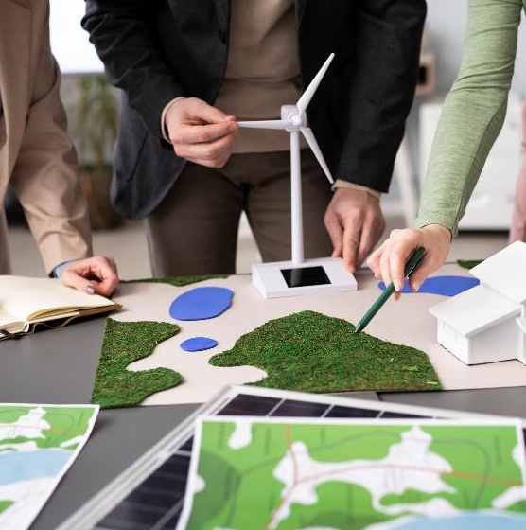



Execution of the pep+ Plan
Now it’s time for the facility to execute on their PepsiCo Positive Plan (pep+ Plan)
CMMs can support by providing access to resources and connecting them with PepsiCo’s sustainability office or PepsiCo facilities implementing similar tactics if they have questions
Resources can be found within the Reduction Finder Tool here (login required) or attached to the external email
For questions, reach out to you PepsiCo relationship Manager

Slide 29
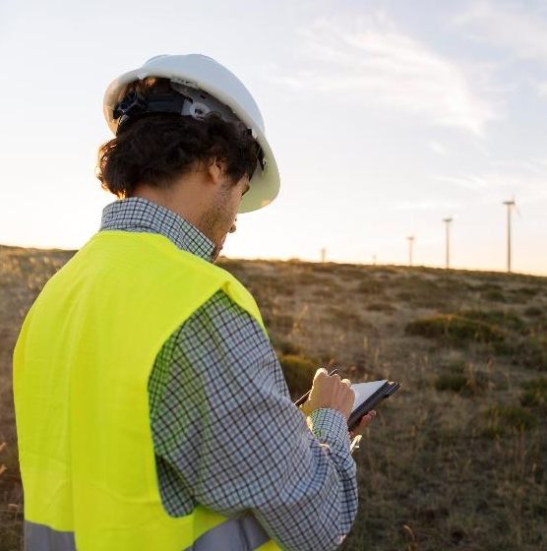
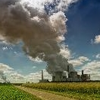
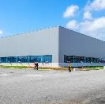
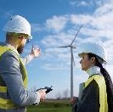
Tracking & Reporting
Every year, facilities must officially provide PepsiCo with data on their greenhouse gas emissions footprint and water use through the annual survey that we send
to them
CMMs should follow up with their facilities to ensure they submit their data before the survey deadline (around end of Q1 of every year)
Throughout the year (e.g., during Quarterly Business Reviews), CMMs should also be checking in with each facility to track progress against their PepsiCo Positive Plan, where they are finding success, and where they could
use additional support, and keep the sustainability
office informed

Slide 30
Appendix

Slide 31




Strategic end-to-end transformation, with sustainability at the center, of how PepsiCo will create growth and value by operating within planetary boundaries and inspiring positive change for the planet and people
POSITIVE AGRICULTURE
POSITIVE VALUE CHAIN
POSITIVE CHOICES
SOURCE crops and ingredients in a way that accelerates regenerative agriculture and strengthens farming communities
MAKE products in a
way that builds a circular,
inclusive economy
INSPIRE people through our brands to make choices that create more smiles for them and the planet
Regenerative Practices
Sustainably Sourced Ingredients
Strengthened Livelihoods
Net Zero Emissions
Net Water Positive
Sustainable Packaging
Meaningful Jobs and Opportunities
Diversity, Equity and Inclusion
Innovative Packaging Solutions
Expanded Portfolio Offerings
Planet + People Brands

Slide 32
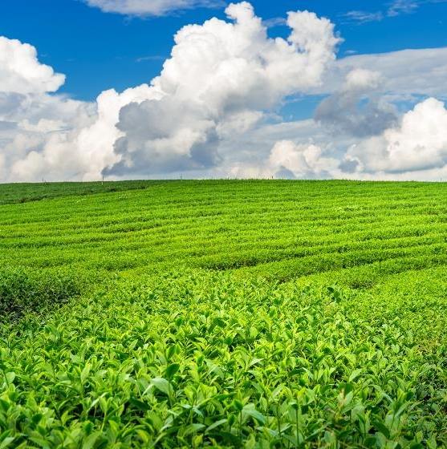
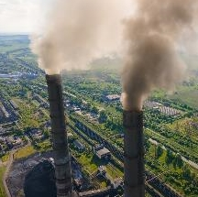
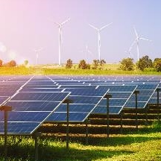


PepsiCo’s Climate Change Goals
Reduce absolute greenhouse gas emissions across our entire value chain (including in our partners’ operations!) by more than 40% by 2030 when compared with 2015, and achieve a 75% reduction in emissions from our own direct PepsiCo operations
Achieve Net Zero emissions across our entire value chain (including in our partners’ operations!) by 2040

Slide 33


Water Use Efficiency Targets
HIGH WATER RISK AREA
Water Use Efficiency:
Improve water use efficiency by 30%⁺ off 2020 baseline by 2030*
OR achieve 1.2 L/L for beverage manufacturing or 0.4 L/KG for foods manufacturing
Replenishment:
100% of PepsiCo product related water use by 2030
ALL OTHER
Water Use Efficiency:
Improve water use efficiency by 15%⁺ off 2020 baseline*
OR achieve 1.4 L/L for beverage manufacturing or 4.4 L/KG for foods manufacturing
*Targets may be adjusted however, burden of proof on co-manufacturing partner to demonstrate that:
They are currently already operating at best practice, and therefore a lower % reduction justified
They are unable to deliver a 30% reduction due to a specific reason (e.g., technical/engineering layout, product type – in relation to non-PepsiCo production) + weighted average In either circumstance, alternative target then to be agreed/negotiated

Slide 34



Our Asks of you as a Strategic Business Partner
Emissions Footprint
Calculate your greenhouse gas emissions footprint and share with us through the annual quality survey
Climate Goal
Set a climate change goal for your organization and initiate Science Based Targets approval
Renewable Electricity
Begin switching to renewable electricity. This is one of the fastest and easiest ways to reduce your emissions today!
Water Use Efficiency*
Measure your water usage and share with us through the annual quality survey
Identify and pursue water savings opportunities
PepsiCo Positive Plan
Build a PepsiCo Positive
Plan (pep+ Plan) for each
facility with your Industry/
Relationship Manager
Implement the planned
reduction tactics
Commitments: -40% GHG Emission by 2030, Net-Zero Emissions by 2040
Commitments for 2030
*Note: CoMans only, excludes RePackers
*Note: there are more goals on top of this for specific partner groups
** Note: Geographical locations where commercially viable as pre-determined.
Notes:
Speaker Erik – text
A little bit of repetition to highlight how important these asks are to us and to call for action!
Calculate your greenhouse gas emissions footprint,
Set and make progress against a Science-Based Target for greenhouse gas emissions reductions,
The easiest way to get started on reducing your emissions is making the switch to Renewable Electricity.
Measure water usage and identify and pursue water savings opportunities, and
For high water risk facilities, develop a plan to meet replenishment goals and collaborate with PepsiCo in shared watersheds

